Slide 1
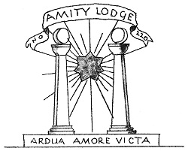
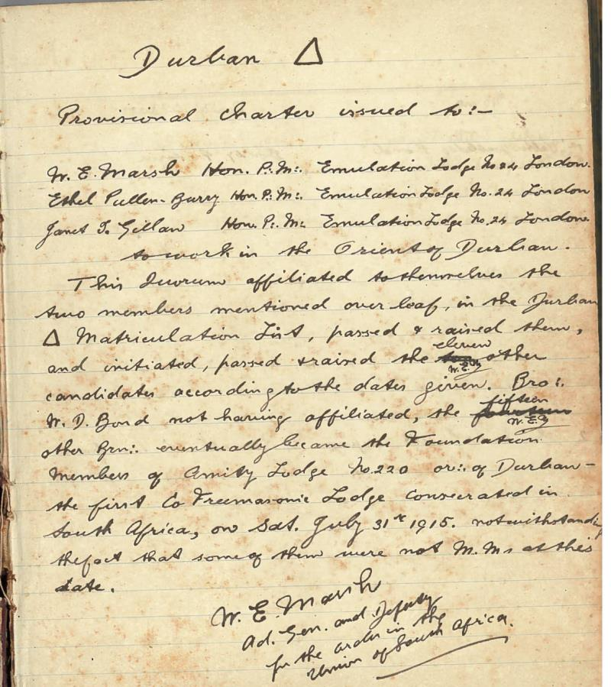
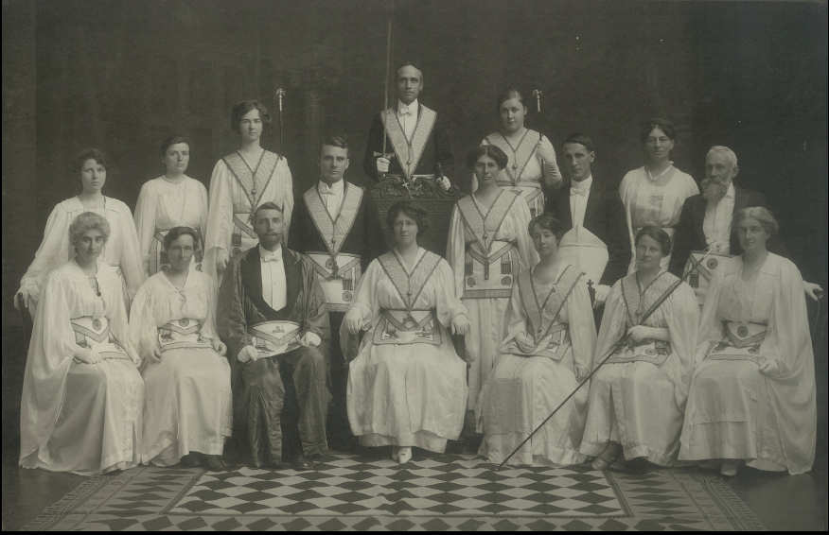
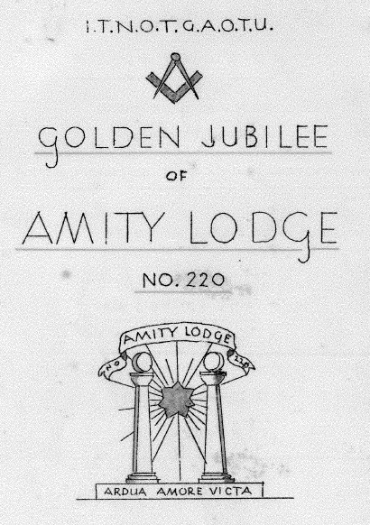
The Second Triangle-
Amity Lodge no 220
was formed in Durban on 12th April 1914
By Brn Marsh, Pullenberry and Gillian
The Mother Lodge of S A
The second triangle was consecrated into a full Lodge on 31 July 1915
Golden Jubilee
April 1965
Went into Abeyance in 2002
Notes:
Here is the handwritten application recorded for properity
The second triangle was consecrated on 31 July 1915 date and was called Amity Lodge no 220 and has always been considered to be the Mother Lodge in S A.
The motto is - Ardua Amore Victa

Slide 2

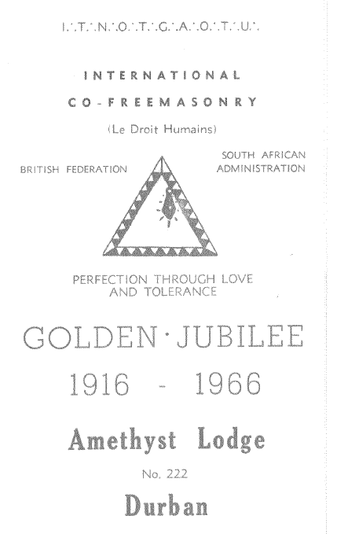
Third Triangle Amethyst Lodge no 222 formed in Pietermaritzburg on 18 September 1914. Consecrated into a full Lodge on 21 October 1915
Golden Jubilee- September 1966
Went into Abeyance in 2002
Notes:
The third triangle was consecrated on 21 October 1918. In PMB and was called Amethyst Lodge no 222. The Lodge moved to Durban. Photo of the consecration. Note Bro William Marsh as RWM.
The Motto – Relief and truth
Meetings were held in hired rooms with a few chairs and tables. There was no storage space in PMB so all masonic furniture was carried in a large Victorian bag, loaded onto a rickshaw.
There was no public transport so bicycles were used. It was a safe at the time to do so.
During this period 11 triangles were formed in various centres. The failure of triangles did not deter the brethren but made them even more determined to put down roots in SA
Picture of 1st officers
The chosen motto was – Relief and truth
Meetings were held in hired rooms with a few chairs and tables. There was no storage space in PMB so all the masonic furniture was carried in a rather large victorian bag, loaded onto a rickshaw . There was no public transport so bicycles were used. It was quite safe at the time to do so.

Slide 3
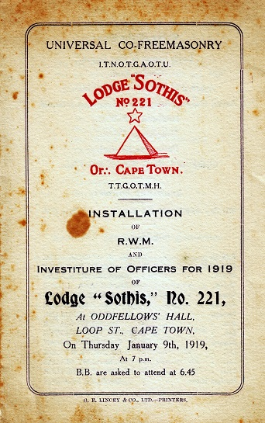
Fourth Triangle
send to Cape Town in December 1914 but did not take off
Fifth Triangle
Cape Town on 5 February 1915
Consecrated as second full Lodge –
Lodge Sothis no 221 on 30 December 1915
Durban Brethren travelled by boat to support Lodge Sothis no 221
The Charter was suspended in December 1920 but re-granted on 16 September 1921
In 1922, Lodge Sothis became Dawn Lodge
With 13 founding members.
Dawn Lodge was closed & charter withdrawn on 13 July 1950.
Notes:
The fifth triangle - Sothis no 221 was consecrated on 5 eb 1915.
Brn travelled on the Union Castle and the first meeting was held

Slide 4
Sixth Triangle
Formed in the Orient of Pretoria on 23 April 1916
Met once, & provincial charter withdrawn on 22 September 1917
Seventh Triangle
Formed in Orient of Johannesburg on 14 June 1916
Charter surrendered as all members left Johannesburg
Eighth Triangle
Formed in lieu of above with permission to work anywhere in the Transvaal. Sufficient Master Masons were created in both Johannesburg and Pretoria to set up independent triangles. The Charter was surrendered.
Ninth Triangle
Formed in Orient of Wynberg (Cape Town) Consecrated as Lodge Hermes Trismegisters no 223 on 28 December 1919.
Notes:
In Martin Melch House in Strand street in CT in the upstairs studio of
the artist Allerly Glossop
Again public transport ( the trams in CT) were used to carry all the masonic furniture – including the wands
Three times the brn traveled the 2000 miles to CT to assist

Slide 5
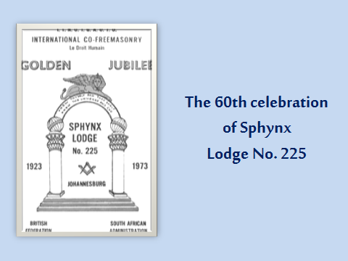
Tenth Triangle
Formed on 14 June 1916 and consecrated as a full Lodge on 29 March 1923.
The Lodge name was chosen as a compliment to the first RWM, RW Sister A Glossop a renowned artist who was initiated in Lodge Sothis no 221.
Know thyself & thy shall know the Universe & God….
Sphynx Lodge no 225
Is still active in
Johannesburg Orient
Notes:
The tenth triangle held its first meeting on 14 June 1916 under the mastership of R W Sister A Glossop. The triangle was consecrated into a full lodge on 29 March 1923.
The name – Sphynx was chosen principally as a compliment to the first RWM, R W Sis A Glossop, an artist of repute in SA whose studio was named SPHYNX.
The motto chosen was –“ Know thyself and thou shall know the universe and God. Thou art the light, let the light shine”
R W Sister Glossop presented a ring containing a scarab to be worn by the RWM of Sphynx. The ivory gavels were presented by Illus Bro Marsh.
Monthly contributions towards was 2/6 and 1/- monthly for the library. At the time the Johannesburg and Pretoria orients shared furniture.
This lodge is still active in Johannesburg.

Slide 6
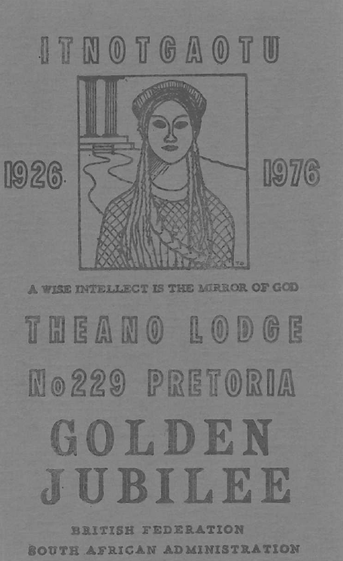
Eleventh Triangle Theano Triangle - Pretoria Orient on 22 April 1919 by Illus Bro A. Glossop . Consecrated on 11 September 1926
“A wise intellect is the mirror of God”
Early meetings were held at
701 Government Av., Arcadia, Pretoria
Initially each mason contributed 2/6 monthly towards furniture which was shared by the Pretoria & Johannesburg Orients.
The survival of this lodges has been due to the unselfish service of the members.
Golden Jubilee 1976
Notes:
The eleventh triangle was formed on 22 April 1919 in Pretoria with Illus Brn Glossop. Five founding members applied for a provincial charter which was granted on 25 May 1926.
The triangle was consecrated into a full lodge on 25 May 1926
The name was chosen being the wife of Pythagorus.
The motto – “A wise intellect is the mirror of God”
Early meetings were held at 701 Government av, Arcadia , Pretoria
The original carpet was donated by Bro R Rowe but was replaced in 1961
The survival of this lodge has been due unselfish service of the members
As early as 1 March 1915v there was clear opposition to Universal Co- Freemasonry as displayed by th efollowing extract from a letter circulated to malecraft lodges in SA.

